Slide 1
Bank Management System
Name & ID:
Shibli Zaman Annan:171-35-2054
Saddam Sek:171-35-2055

Slide 2
Bank Management System
Purpose:
Bank Management System is used to Keep the records of clients, employee etc in Bank. The bank management system is an application for maintaining a personal account in a bank . The system provides the access to the customer to create an account, deposit/withdraw the cash from his account, also to view reports of all accounts present.

Slide 3
Bank Management System
Objective:
This system provides the basic services to manage bank accounts at a bank. Bank has many branches, each of which has an address and branch number. A client opens accounts at a branch. Each account is uniquely identified by an account number; it has a balance and a credit or overdraft limit. There are many types of accounts, including: A saving account, a student account, and a credit card account. It is also possible to have a joint account.

Slide 4
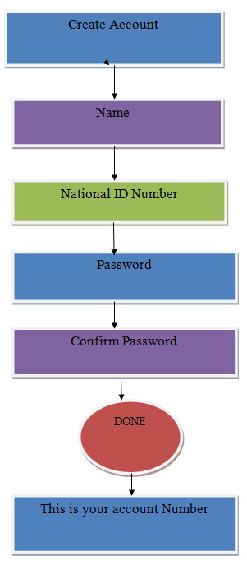

Slide 5
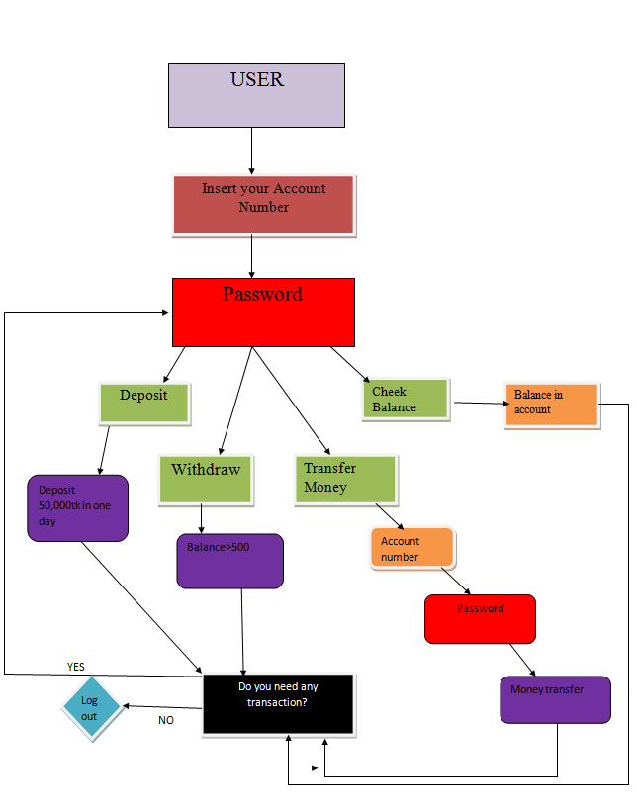

Slide 6
Bank Management System
Functional Requirements:
Name
National ID Number
Password
Account Number
User
Password
Deposit
Withdraw
Cheek Balance
Transfer Money
Logout

Slide 7
Bank Management System
Non-functional Requirements:
Create Account
Confirm Password
Done
Insert your Account Number
Balance in Account
Account Number
Password
Money Transfer
Balance>500
Deposit 50,000tk in one day
Do you need any transaction?
YES/NO

Slide 8
Bank Management System
Problems:
In this bank Management system does not use in messaging option for account holder. If anyone deposit or withdraw money from his account a simple massage will go to his phone number but it does not use in the program.
An account holder how much interest on his deposit money it does not specified. As a result, the account holder does not know what is the interest he will get.

Slide 9
THANK YOU

